Slide 1



THiS – Workshop #2:
Developing own ideas I

Slide 2
Objectives for the workshop?
To get to know methodologies from the Design Thinking context, and be able to use them for your own events

Slide 3
Recap – objectives and outputs for and of Type A events
Who remembers?

Slide 4
What we are going to do
– Type A
Goals:
deal with the socioeconomic challenges of their home region;
learn about regional development activities in their home region - some of them being funded or co-funded by the EU through its Cohesion Fund instruments;
develop their own plans how to overcome and remedy the particular regional challenges – possibly by utilising the public support that is provided by Cohesion Fund instruments;
prepare a Regional Development Resolution – a formal request for a specific regional development issue that is presented to the policymakers who are invited to the events and sent to all political representatives in the local or regional legislatures. It will also be communicated to the local media.

Slide 5
Our concept for project days
Input and transfer
Developing own ideas
Dialogue with decision-makers

Slide 6
Schedule of Type A event
(Example)
08:00 – 08:15 Introduction
08:15 – 08:40 What is the EU? - The EU Cohesion policy
08:40 – 09:40 Jigsaw puzzle – How does the EU work at a regional level?
10:00 – 12:00 Design Thinking workshop for REGION
12:00 – 12:45 Presentation of ideas and dialogue with decision-makers
12:45 – 12:55 Evaluation and reflection

Slide 7
Our concept for project days
Input and transfer
Developing own ideas
Dialogue with decision-makers

Slide 8
Contribution of input and transfer phase to learning objectives Type A events
deal with the socioeconomic challenges of their home region;
develop their own plans how to overcome and remedy the particular regional challenges – possibly by utilising the public support that is provided by Cohesion Fund instruments;
prepare a Regional Development Resolution – a formal request for a specific regional development issue

Slide 9
Schedule of Type A event
(Example)
08:00 – 08:15 Introduction
08:15 – 08:40 What is the EU? - The EU Cohesion policy
08:40 – 09:40 Jigsaw puzzle – How does the EU work at a regional level?
10:00 – 12:00 Design Thinking workshop for REGION
12:00 – 12:45 Presentation of ideas and dialogue with decision-makers
12:45 – 12:55 Evaluation und Reflexion

Slide 10
Design Thinking in educational settings

Slide 11
What is Design Thinking?
„At the same time, it is a method, a set of principles, a special point of view and a process with a plethora of supporting tools.“
(Gabler Wirtschaftslexikon, Last accessed on March 27th, 2026 – own translation)

Slide 12
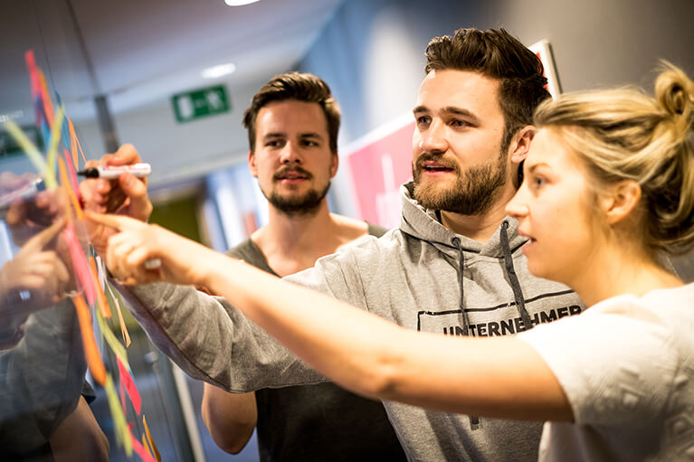
What is Design Thinking?
An approach to solving complex problems in teams that are as diverse as possible
The process is modelled on the work of architects and designers
Objective: to generate as many ideas as possible, building on others’ suggestions
The solution is user-centred
Etventure.de

Slide 13
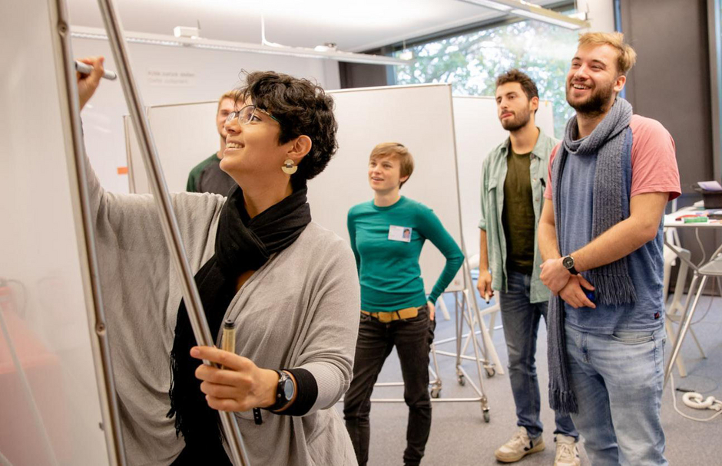
Why Design Thinking?
Promoting innovation and collaboration
Enhancing problem-solving skills through a multi-perspective approach
Can be applied to a wide range of problem areas
Individual methods can be adapted to suit specific needs
Hasso-Plattner-Institut

Slide 14

Design Thinking Workshop
for REGION

Slide 15
Design Thinking process
Notes:
There are six phases within the DT process; we have also added a seventh phase, ‘Reflection’, as it is important to learn from one’s actions.
Understanding:
In this phase, we aim to learn more about the potential user, their needs and tasks. We want to identify a problem and try to understand it.
Observation:
This phase is about capturing reality. It involves observing the user in real-life situations or within the context of the problem.
Defining a stance:
In this phase, we focus on evaluating, interpreting and prioritising the insights gathered. We lay the foundations upon which to build solutions.
Gathering ideas:
As the name suggests, this involves gathering ideas through brainstorming. It is important here to be open-minded and to generate as many creative ideas as possible.
Prototype:
Building prototypes helps us to visualise and test our ideas.
Testing:
Again, this is fairly self-explanatory: the prototypes are tested. A key point here is the feedback, which in turn feeds back into the DT process. (See arrows in the diagram)
Reflection:
An important, if not the most important, step is reflection at the end of the DT process. Reflection helps us to learn and consolidate the knowledge we have gained, improve processes and ultimately arrive at better solutions.

Slide 16
Design Thinking process - Rules
  “If your mindset is open-minded... it is open to everything. In the mind of a beginner there are many possibilities, but in the mind of an expert there are few.” – Shunryu Suzuki
  Free from preconceptions about how something works
  Free from expectations about what will happen
  Filled with a curiosity to understand things more deeply
  Fail early and often, learn quickly
Notes:
In principle, you are responsible for your own work, the structure of your discussions, etc., within your groups, and are free to organise things as you see fit, but there are a few rules

Slide 17
Design Thinking process

Slide 18
Challenges and issues in TOWN/REGION
Personal reflection:
What do you feel is missing in your town or region? What problems do you identify in your town or region?
Think about social and economic factors, as well as the environment.
Write down your thoughts on the sheets of paper provided.
Allocated time: 5 mins

Slide 19
Challenges and issues in TOWN/REGION
Group discussion:
What problems and challenges have you noted down? Discuss your findings in your groups!
Agree on one problem that you want to tackle today.

Slide 20
Challenges and problems
Notes:
Once you’ve outlined a problem in broad terms – such as green spaces or mobility – the ‘problem statement’ method focuses on understanding the problem more clearly and making it equally accessible to everyone. This phase is absolutely crucial, because in the DT process you never start with a solution; you always begin with a problem. The better you understand the problem, the better you can find solutions that are precisely tailored to it.

Slide 21
Challenges and problems
Problem statement:
Answer the questions to gain a better understanding of your problem and to ensure it is clear to everyone!
Be precise and take the time to answer the questions as accurately as possible, providing detailed explanations.

Slide 22
Discussion of the challenges and problems

Slide 23
Design Thinking process

Slide 24
Jobs to be done
What needs to be done to solve the problem?
Notes:
The task now is to analyse the insights gained from the ‘problem statement’ and use them to formulate specific design challenges. In other words, we need to consider what kind of solution is actually required and why. To do this, we will be using the ‘Jobs to be Done’ methodology.

Slide 25
Notes:
The Jobs to be Done approach focuses on solving problems in a way that helps users move forward and enables them to complete their tasks.
For example:
When I take a photo with my mobile phone I want to be able to edit it easily So that I can share it quickly with my friends
Jobs to be done therefore consists of three phases:
Description of the situation
Explanation of the motivation
What result is expected

Slide 26
Jobs to be done
Jobs to be done:
Work individually! Come up with as many ‘jobs to be done’ as possible!
The situation description should outline specific scenarios within your problem, so that you can then understand what needs to be changed (motivation) and what you aim to achieve (goal).
Pay attention to precision and take the time to answer the statements as accurately as possible and to differentiate between them.
Discuss your results in the group!

Slide 27
Design Thinking process

Slide 28
Collect ideas
Brainstorming:
Think individually (!) of ways in which your chosen problem could be solved. Write each idea on a sticky note.
Everyone should come up with as many ideas as possible!
Notes:
We’ll start with a brainstorming session, but really it’s more of a brain dump to begin with. So first, just get everything out that comes to mind, and then we’ll use the brainstorming session to develop your ideas further together.
Important rules:
Creative self-confidence
Quantity is more important than quality
No preconceptions
Fail often and early – that’s the only way to make progress

Slide 29
Collect ideas
Brainstorming together:
Organise the ideas within your group. Remove any duplicates.
Arrange the various ideas for solving the problem on the large sheet of paper to get a clear overview.
Keep thinking, combine ideas and refine them!

Slide 30
Break

Slide 31
Design Thinking process

Slide 32
I like…, I wish…, I wonder…
Expand on brainstorming and refine ideas
Notes:
This method is about exploring and refining the idea you have chosen. The ‘I like, I wish, I wonder’ method involves a brief reflection to help you improve your idea through constructive feedback.

Slide 34
I like…, I wish…, I wonder…
Reflection:
First, reflect on your ideas individually!
What do you like about them? What would you like to see included? And where do you see further possibilities or challenges that your idea might face?
Make sure to adopt a constructive approach! Every idea can be improved!

Slide 35
Design Thinking process

Slide 36
Preparing a presentation
Prepare a presentation!
As you do so, bear in mind the design thinking process and your own reflections to explore possibilities for the future.
Structure:
Problem
Idea
Reflection

Slide 37
…questions?

Slide 38
What else is possible for this part of the event?

Slide 39
Questions?

