Slide 1



THiS – Workshop #1:
Input and transfer

Slide 2
Objectives for the workshop?
To deepen the understanding of the Type A concept you could use
To become familiar with the content and methodologies we use for our Type A events
To better understand Cohesion policy
Clarify questions on first part of Type A events

Slide 3
Recap – objectives and outputs for and of Type A events
Who remembers?

Slide 4
What we are going to do –
Type A
Goals:
deal with the socioeconomic challenges of their home region;
learn about regional development activities in their home region - some of them being funded or co-funded by the EU through its Cohesion Fund instruments;
develop their own plans how to overcome and remedy the particular regional challenges – possibly by utilising the public support that is provided by Cohesion Fund instruments;
prepare a Regional Development Resolution – a formal request for a specific regional development issue that is presented to the policymakers who are invited to the events and sent to all political representatives in the local or regional legislatures. It will also be communicated to the local media.

Slide 5
EUD concept for project days
Input and transfer
Developing own ideas
Dialogue with decision-makers

Slide 6
The Laura Lundy model of participation
The Laura Lundy model
Space
Voice
Audience
Influence
Notes:
…this goes along with The Laura Lundy model of participation
Space Safe, inclusive environments where students feel comfortable expressing opinions. Example: Use familiar settings (e.g., classrooms) and allow time for reflection.
Voice Participatory methods to help students articulate their views. Example: Debates, role-play, or creative writing (e.g., Ibiza scandal story).
Audience Decision-makers who listen and engage with student ideas. Example: Invite local politicians or journalists to respond to student presentations.
Influence Show impact of student input through follow-up and transparency. Example: Share student resolutions with media or policymakers.

Slide 7
Schedule of Type A event (Example)
08:00 – 08:15 Introduction
08:15 – 08:40 What is the EU? - The EU Cohesion policy
08:40 – 09:40 Jigsaw puzzle – How does the EU work at a regional level?
10:00 – 12:00 Open Space workshop for REGION
12:00 – 12:45 Presentation of ideas and dialogue with decision-makers
12:45 – 12:55 Evaluation und Reflexion

Slide 8
Our concept for project days
Input and transfer
Developing own ideas
Dialogue with decision-makers

Slide 9
Contribution of input and transfer phase to learning objectives Type A events
deal with the socioeconomic challenges of their home region;
learn about regional development activities in their home region - some of them being funded or co-funded by the EU through its Cohesion Fund instruments;
→ The focus on regional development offers a unique opportunity to create a direct connection between the everyday lives of European citizens and European decision-making. Cohesion Policy and all its instruments have a direct impact on local communities that people can experience in concrete terms

Slide 10
Schedule of Type A event
(Example)
08:00 – 08:15 Introduction
08:15 – 08:40 What is the EU? - The EU Cohesion policy
08:40 – 09:40 Jigsaw puzzle – How does the EU work at a regional level?
10:00 – 12:00 Open Space workshop for REGION
12:00 – 12:45 Presentation of ideas and dialogue with decision-makers
12:45 – 12:55 Evaluation und Reflexion

Slide 11
EUROSOC#DIGITAL
A non-profit organisation and independent think tank based in Berlin
Areas of focus: EU regional policy, sustainable development, climate policy, new technologies, participatory formats
Organising project days on European policy education and developing teaching materials

Slide 12
Goals of the event
Gaining an understanding of EU Cohesion policy as a key area of EU policy
Identifying the main challenges and issues facing one’s own region or city
Developing and evaluating solutions to these issues
Learning methods for structured problem-solving (Liberating Structures)

Slide 13
Citizens, Equality, Rights and Values (CERV)
Cof-unded this event
The European Union’s ‘Citizens, Equality, Rights and Values’ (CERV) programme supports projects focusing on EU values, equality, participation and the prevention of violence.
Main Goals:
Strengthening European values
Further development of a rights-based, open and democratic society

Slide 14
Schedule of Type A event
(Example)
08:00 – 08:15 Introduction
08:15 – 08:40 What is the EU? - The EU Cohesion policy
08:40 – 09:40 Jigsaw puzzle – How does the EU work at a regional level?
10:00 – 12:00 Open Space workshop for REGION
12:00 – 12:45 Presentation of ideas and dialogue with decision-makers
12:45 – 12:55 Evaluation und Reflexion

Slide 15
Before we start…
… what is the EU?

Slide 16
EU Cohesion policy

Slide 17
Why Cohesion policy?
Goal: To strengthen economic and social cohesion within the EU.
By reducing regional disparities between the different regions in the EU
  Equal standards of living within the EU
Promoting economic growth, employment and quality of life in all EU regions and cities.
Cohesion policy is a solidarity-based investment policy.

Slide 18
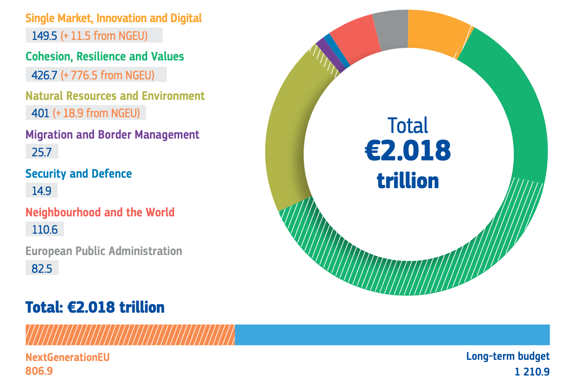
Cohesion policy in the
EU budget
Source: European Commission

Slide 19
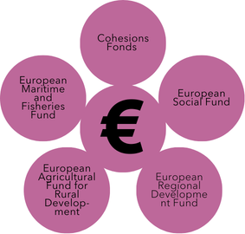
The EU‘s Structural and Investment Funds (ESIF)
Own graphic

Slide 20

The European Committee of the Regions (CoR)
350 regional and local representatives
The youngest of the European institutions
‘Europe from the bottom up’
Activities:
  Comments on legislation affecting the regions
  Studies on regional development and local issues
  Events organised by the regions and towns

Slide 21
Projects in your own region
Research for projects: https://what-europe-does-for-me.europarl.europa.eu/en/region
https://kohesio.ec.europa.eu/en/

Slide 22
Background knowledge:
Why Cohesion policy?
Royuela and López-Bazo (2020) explain that the focus, design, management and allocation of funds have made regional policy a very powerful tool for contributing positively to the development of a European identity, which can ultimately lead to identification with the European project as such.
This finding is supported by Borz, Brandenburg and Mendez (2022), who have found that citizens' perception of the benefits of regional policy for themselves and the development of their region contributes to the development of a European identity.
The H2020 PERCEIVE project supports this argument by stating that awareness and appreciation of regional policy act as a ‘vaccine against populism’ (PERCEIVE: 2019).

Slide 23
Our concept
Input and transfer
Developing own ideas
Dialogue with decision-makers

Slide 24
Schedule of Type A event (Example)
08:00 – 08:15 Introduction
08:15 – 08:40 What is the EU? - The EU Cohesion policy
08:40 – 09:40 Jigsaw puzzle – How does the EU work at a regional level?
10:00 – 12:00 Open Space workshop for REGION
12:00 – 12:45 Presentation of ideas and dialogue with decision-makers
12:45 – 12:55 Evaluation und Reflexion

Slide 25
The method jigsaw puzzle

Slide 26


Jigsaw puzzle
How does the EU work at a regional level?

Slide 27
How does the eu work at a regional level?
During the following exercise we will have a closer look at the implementation of political objectives of the European Commission through Cohesion policy by using a methode called „jigsaw puzzle“

Slide 28
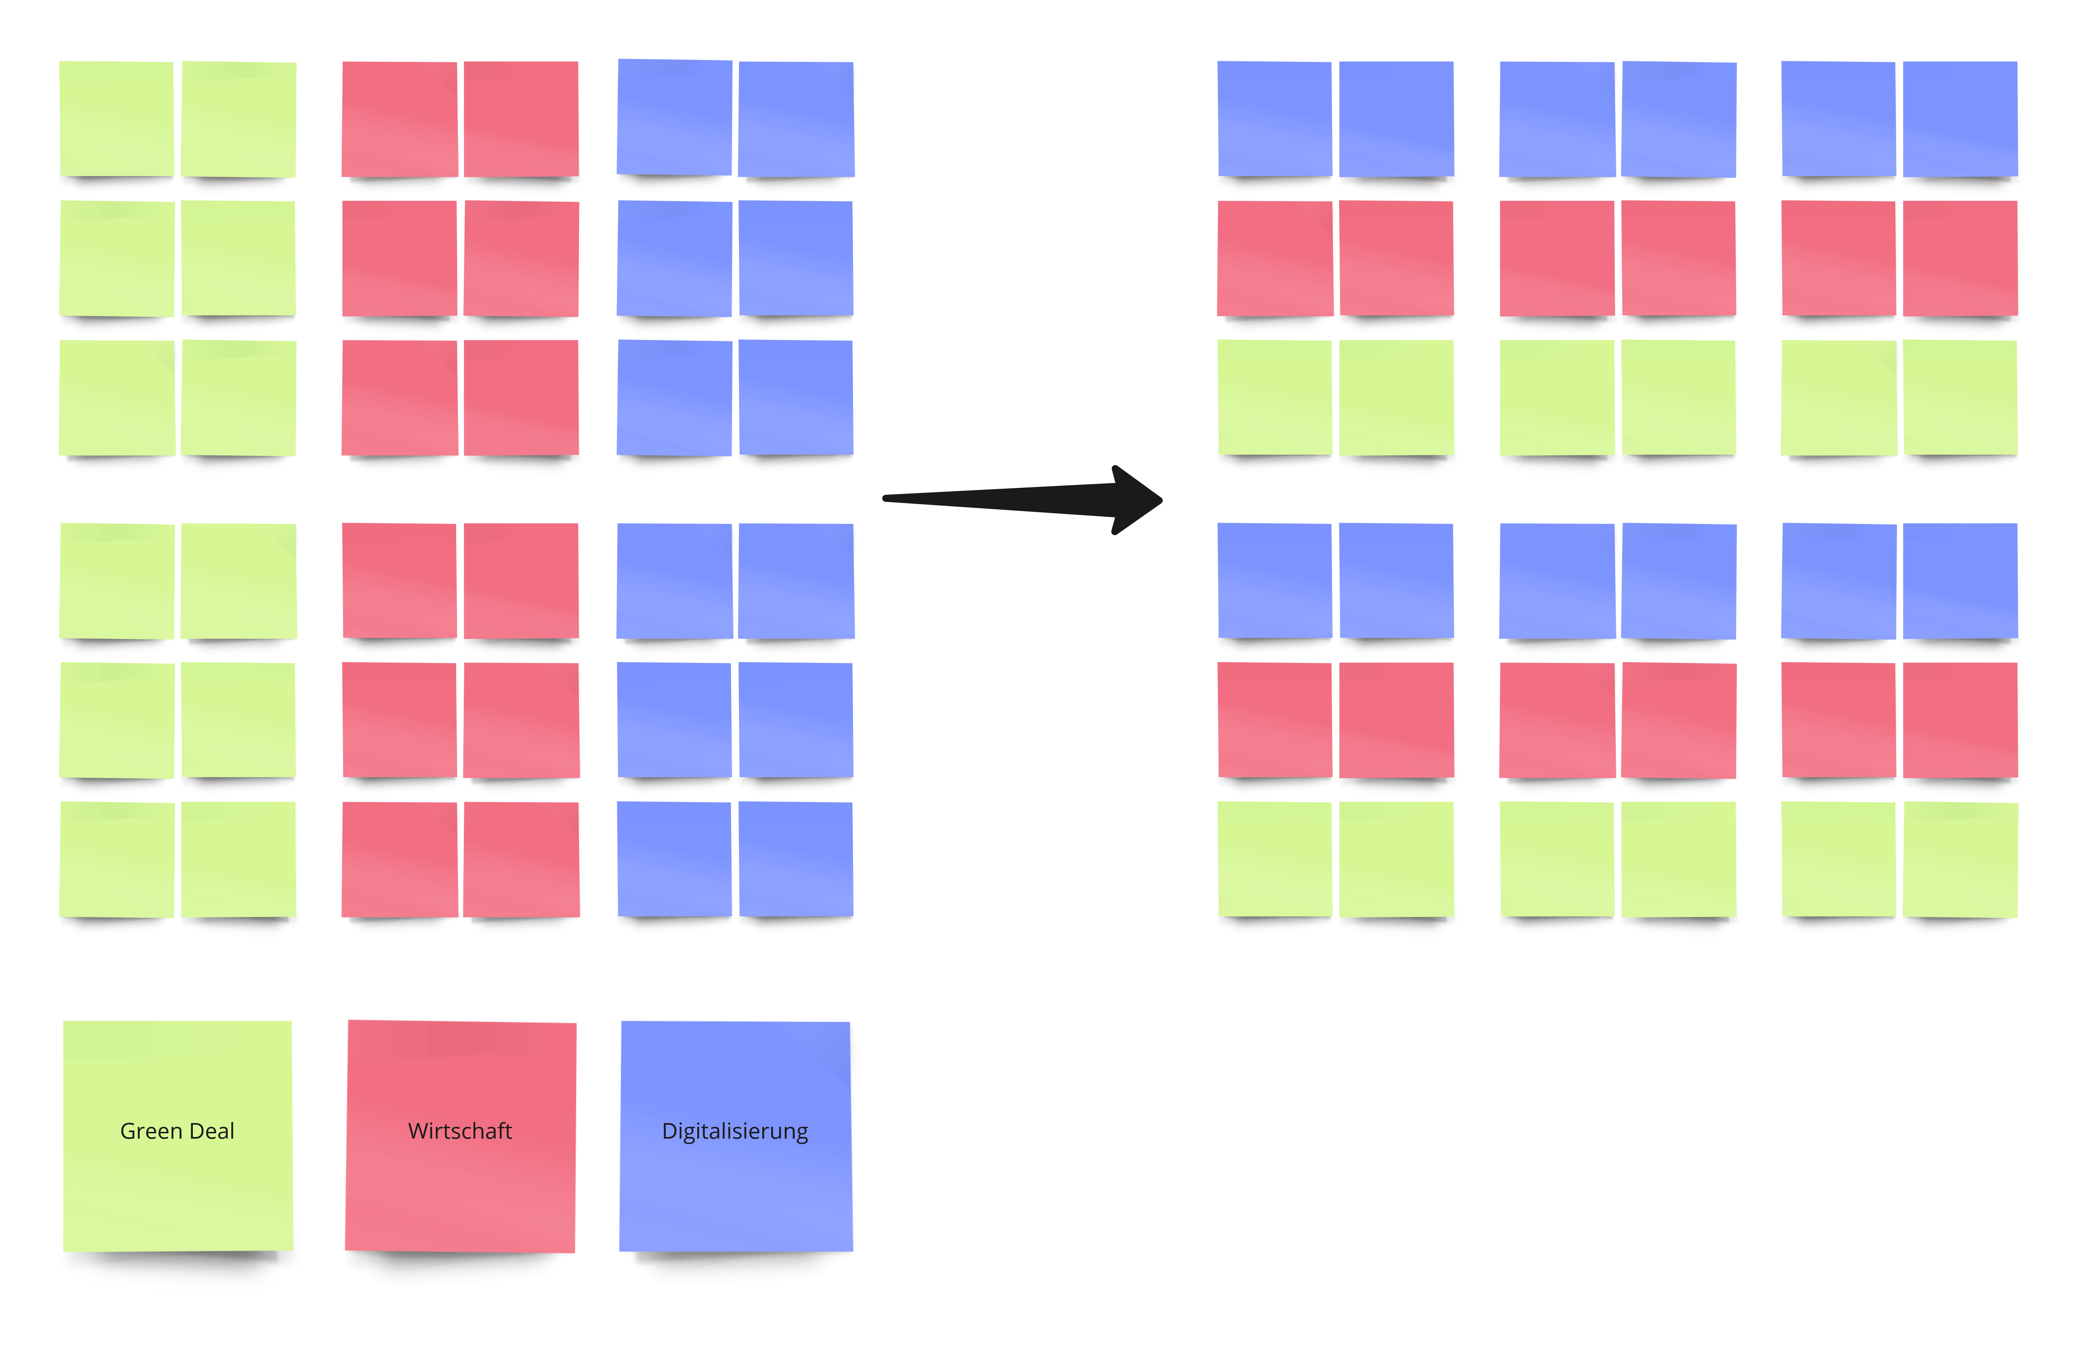
Jigsaw puzzle - instructions
Expert groups Core groups
Green Deal
Economy
Digitalization

Slide 29
Expert groups
Overview:
What‘s your topic?
What objectives does the EU Commission set for your topic?
How are these goals going to be implemented? Can you think of any other possibilities?
Connection:
Are there any examples to show how objectives of the COM are implemented locally?
  Draw a connection between the objectives of the COM and the projects from your topic.
Important: Write down notes!
You are going to share your results in the next stage.

Slide 30
Jigsaw puzzle - instructions
Expert groups Core groups
Green Deal
Economy
Digitalization

Slide 31
Core groups
Overview:
Share your results
Connection:
What do the different areas have in common?
What are the differences between the topics in terms of implementation in the regions?
What opportunities and difficulties do you see with regard to implementation?
Important: Write down notes!
You are going to present your results in the next stage.

Slide 32
Discussion of results

Slide 33
What are typical answers given by youngsters?
Economy vs. Climate
Expensive – no money
Everyone has to participate
→ In general, it is easier for them to find challenges

Slide 34
Similarities
All areas have a local level
Implementation on the ground
Overlapping potential of the topics
Becomes clear with the goal of an "economy that works for everyone": Economy as a tool for implementing the other goals
Future potential
EU as a pioneer in the field of sustainable development and digitalization?

Slide 35
Discussion of results

Slide 36
Differences
Clear outline for Green Deal and Digitalization; Economy rather as means to an end
Less concrete targets for the economy

Slide 37
Discussion of results

Slide 38
Challenges
Depending on point of view: objectives can eliminate or contrast themselves (economy green deal)
New projects are not necessarily more sustainable than old projects
How high are ecological costs for economic and digital development?

Slide 39
Discussion of results

Slide 40
Chances
Combining areas:
More sustainability through digitalization, boosting the economy through the potential to be a pioneer in the development of sustainable solutions (e.g. renewable energies, mobility sector, agriculture)

Slide 41
Discussion of results

Slide 42
Cohesion Policy
European Cohesion policy is by no means abstract and distant, but takes place locally in the regions.
As citizens, we have the opportunity to contribute our ideas to the development of our home region in line with European objectives.

Slide 43
Cohesion Policy
What possibilities can you think of for citizens to actively participate?

Slide 44
…questions?

Slide 45
What other exercises can be used for this part of the event?
Notes:
https://www.eu-im-unterricht.de/en/all-lesson-plans/eu-regional-policy-and-european-identity-a-natural-connection/
https://www.eu-im-unterricht.de/en/all-lesson-plans/eu-regional-policy-in-quotes/
https://www.eu-im-unterricht.de/en/all-lesson-plans/how-do-regions-get-money-from-the-european-union/
https://www.eu-im-unterricht.de/en/all-lesson-plans/die-eu-in-meinem-leben-geschichten-von-unionsbuergerinnen/
https://www.eu-im-unterricht.de/en/all-lesson-plans/the-history-of-eu-cohesion-policy/

